Slide 1


Microsoft 365 Copilot Cowork
alexander.Kastil@integrations.at

Slide 2






Alexander Kastil
Agentic AI — From Strategy to Production
AI Transformation
Value Discovery, KPI Mapping & Roadmap
Agentic Architecture
Architecture & Business Process Design
01
02
Agentic Software Engineering
Claude Code & GitHub Copilot
Training & Team Enablement
Hands-on workshops to make AI stick
03
04
integrations.at | alexander.kastil@integrations.at | linkedin.com/in/alexander-kastil | github.com/alexander-kastil

Slide 3
Agenda
Getting Started with Cowork
Understanding Skills: Built-in Skills & the Side Panel
Creating Custom Skills with SKILL.md
Scheduling Prompts & Recurring Automation
Extending Cowork with Plugins
Human-in-the-Loop: Approving Actions & Staying in Control

Slide 4
Getting Started with Cowork

Slide 5
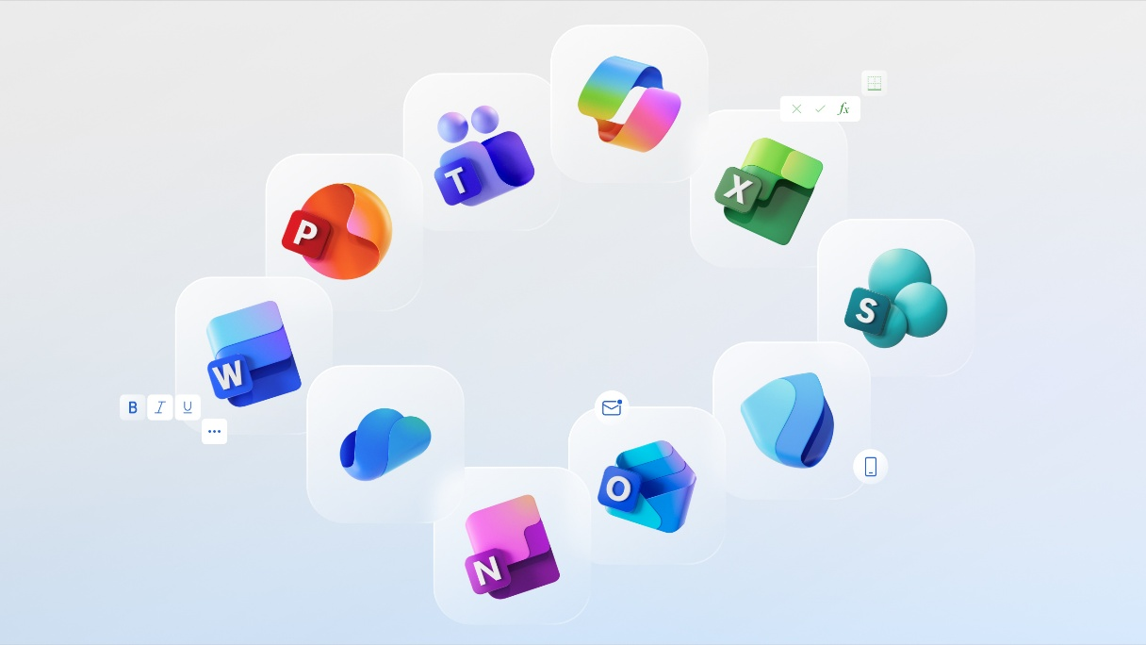
What Cowork Is
Agentic AI that does multi-step work across Microsoft 365 on your behalf
You describe an outcome in plain language; Cowork plans and executes the steps
Generally available since June 2026 to all Microsoft 365 Copilot tenants
Runs on Anthropic (Claude) models; you approve before anything is sent or saved

Slide 6
Cowork vs Copilot Chat
Copilot Chat: fast, single-session drafting, summarizing, and answering
Cowork: end-to-end, multi-step work across apps (minutes to hours)
Chat is your thought partner; Cowork is the colleague who does the work
Reach for Cowork when you need action taken, not just a suggestion

Slide 7
Access, Models & the Interaction Loop
Use it in the browser (m365.cloud.microsoft), Outlook, Teams, desktop, and mobile
Model picker: Claude Opus 4.8, Sonnet 5, Fable 5 (preview), or let Cowork decide
Describe the task, watch it work step by step, and steer at any time
It pauses for approval before sensitive actions, each marked with a risk level
Describe the task
Cowork works the steps
Approve sensitive actions
Review the result

Slide 8
Understanding Skills: Built-in Skills & the Side Panel

Slide 9
The Built-in Skill Catalog
Word, Excel, PowerPoint, PDF, Email, Scheduling, Calendar, and Meetings
Daily Briefing, Enterprise Search, Deep Research, Communications, Adaptive Cards
Cowork loads the right skills automatically from the task you describe
You never pick a skill by name; its description decides when it fires

Slide 10
The Side Panel & Where Skills Come From
The side panel is a live view of which skills are active at each step
Watch it to see how Cowork decomposes a request into an ordered plan
Four sources: built-in, your custom skills, plugins, and admin-deployed plugins
All surface in the same panel and activate the same way, from the task
Built-in skills
Custom skills
Plugins
Admin-deployed
Side panel

Slide 11
Creating Custom Skills with SKILL.md

Slide 12
Author a Skill in Plain Language
A skill is a name, a description, and plain-language instructions
Store it at OneDrive /Documents/Cowork/skills/<name>/SKILL.md
The name is kebab-case and must match the folder name exactly
Up to 50 custom skills; Cowork discovers them at the start of each session

Slide 13
The Description Is the Trigger
Cowork reads the description to decide when a skill applies
Be specific and trigger-oriented; a vague description rarely fires
Add companion files (templates, references) next to the SKILL.md
Create one from the Customize page, in chat, or by adding the file in OneDrive

Slide 14
Scheduling Prompts & Recurring Automation

Slide 15
Run Any Prompt on a Schedule
Write the prompt once, then set a recurrence (daily, weekly, or monthly)
Cowork runs it automatically and delivers the result at each interval
Manage everything from the Scheduled tab: pause, edit, or delete
Point a schedule at a custom skill: the skill is the how, the schedule the when
Write the prompt
Set a recurrence
Cowork auto-runs
Approve to send

Slide 16
Automation Still Stops for Approval
Scheduling the run does not schedule the send
High-risk steps (email, Teams post) still pause for your go-ahead each time
Automation removes the repetitive work, not your control over what leaves
Good candidates: daily briefings, weekly status reports, monthly digests

Slide 17
Extending Cowork with Plugins

Slide 18
What Plugins Add
Plugins reach beyond Microsoft 365 to external data and specialized expertise
A plugin bundles agent skills and connectors in the open SKILL.md format
Marketplace plugins: Dynamics 365, Fabric IQ, Jira, Salesforce, ServiceNow, SAP, Workday
Admins can deploy plugins organization-wide
Marketplace plugin
Skills + connectors
Cowork

Slide 19
Installing & Managing Plugins
Add plugins from the Microsoft 365 marketplace on the Customize page
Once added, plugin skills appear beside built-in skills and load automatically
Toggle plugins per conversation from the Sources & Skills panel
The community also publishes ready-to-install Cowork plugins

Slide 20
Human-in-the-Loop: Approving Actions & Staying in Control

Slide 21
The Approval Model & Risk Levels
Cowork pauses before anything that leaves a mark: send, post, or save
Each action button reflects exactly what will happen; nothing commits until you confirm
Risk levels: Low (draft, search), Medium (save, schedule), High (send, post)
Allow similar actions for the rest of a session to skip repeat prompts
Low
Draft, search
Medium
Save, schedule
High
Send, post

Slide 22
Steer, Rate & Govern
Pause, resume, cancel, or interrupt to redirect an active task
Rate responses with thumbs and leave inline comments to correct them
Admins set agent availability (all, specific groups, or blocked) in the admin center
Spending policies with monthly and per-user limits cap Copilot Credit usage

